Slide 1
Agenda 8/25/14 * I can identify direct & indirect characterization.
1. Bellringer *Reread your bellringer from Friday. Make a prediction about what is going to happen next in the story.
2. Types of Characters
3. Indirect & Direct Characterization Chart.
4. Finish reading “The Most Dangerous Game.”
5. SSR
6. Exit Slip: What did you learn from Rainsford’s experience?

Slide 2
Methods of Characterization
There are two types of characterization, direct and indirect.
Direct characterization tells the reader directly about the character.
Indirect Characterization is when the author tells about a characters looks, what they do or say, how the characters reacts, and how the other characters act or say about that character. The reader draws the conclusions.
Indirect: Ivan "He is a gigantic creature, solidly made and black bearded to the waist."
Direct: Zarroff "He had the face of a man used to giving orders, the face of an aristocrat."

Slide 3
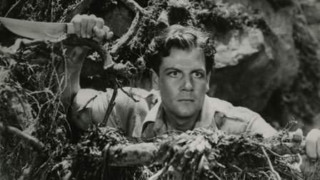
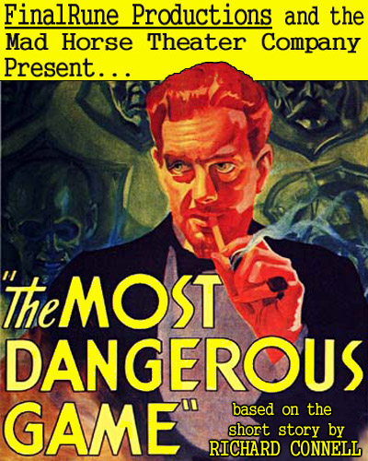
Protagonist
Protagonist: The leading character, the main character, or the hero
The protagonist in the story is Rainsford. This is because we follow him throughout the story, and have heard his thoughts and feelings

Slide 4
Using your chart, as you read…
Identify characterization, choose the correct type, and make an assertion about the character based on what you learn about them.

Slide 5
Antagonist
Antagonist: The character or group of characters, that’s are opposed to, or competes with the protagonist.
In The Most Dangerous Game the antagonist is General Zaroff because he clearly opposes and competes with Rainsford.

Slide 6
Sites Used:
http://dictionary.reference.com/browse/antagonist
http://en.wikipedia.org/wiki/Antagonist
http://web.cn.edu/kwheeler/lit_terms_R.html
http://dictionary.com
Images:
http://www.criterion.com/films/584-the-most-dangerous-game
http://www.sffaudio.com/?p=11218

Slide 7
Agenda 8/26/14 * I can analyze a character.
1. Bellringer * How do you think Rainsford feels about being hunted now? Remember before when he said there were only 2 types of the people, hunters & huntees?
2. Finish reading & adding to character chart- you need 8 entries by the end of class.
3.Plot Diagram
4. Character Types & Changes
5. Exit Slip * What is “the most dangerous game”?

Slide 8
Agenda 8/27/14
Bellringer: From the story, what is “the most dangerous game?”
Notes on types of characters.
Characterization of Gerneral Zaroff

Slide 9
Characterization
Task: pretend that you must describe your best friend or a close family member to someone who has never them.
Write a paragraph that will help me to better understand your person.
Share with your shoulder partner: when you hear a character trait, I want you to write it down.

Slide 10
Character and Characterization
What kinds of traits did we come up with today?
Brown eyes- physical trait
Funny
Short- physical trait
Crazy
Hyper
Musically inclined
Outgoing
Friendly
Understanding
Caring
Trustworthy
Dumb
Responsible
Generous
Outgoing
Angry
Annoying
Shy
Energetic
Elderly
Independent
Sweet
Hardworking
Ghetto
Redneck

Slide 11
Round vs. Flat
Round: A round character is depicted with such depth and detail that he or she seems like a "real" person. In The Most Dangerous Game Rainsford is a round character because we hear what he is feeling, and get a greater understanding of who he is.
Flat: A flat character is a character who serves a minor literary function in a text. In The Most Dangerous Game Ivan is a flat character because he only plays a small part in the General’s game, and the plot itself.

Slide 12
Static vs. Dynamic
Static: A character or characters that do not grow or change throughout full story.
Dynamic: A character who goes through an important inner change over the coarse of the story.

Slide 13
Dynamic & Static
At the end of this experience, how has Rainsford changed and become a DYNAMIC CHARACTER? Rainsford changes his mind about the hunted at the beginning thinking that the hunted has no feelings. After being hunted he realizes that they do have feelings and experience fear.
What makes Zaroff a STATIC CHARACTER – one who never changes?
General Zaroff does not change during the whole story. His personality and attitude stay the same, therefore he is a static character

Slide 14
Ape Genius
http://www.pbs.org/wgbh/nova/nature/ape-genius.html

